Slide 1
Data Structures

Slide 2
Agenda
Diameter of a Binary Tree

Slide 3
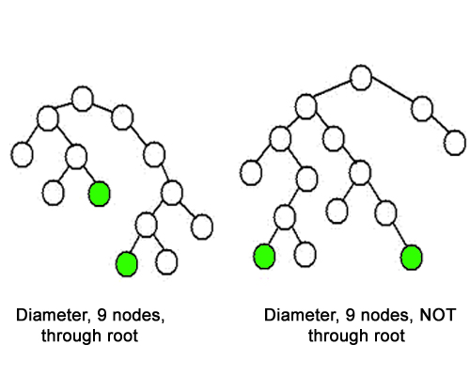
Diameter of a Binary Tree
Link: https://practice.geeksforgeeks.org/problems/diameter-of-binary-tree/1/

Slide 4
Diameter of a Binary Tree
Link: https://practice.geeksforgeeks.org/problems/diameter-of-binary-tree/1/

Slide 5
Diameter of a Binary Tree
Link: https://practice.geeksforgeeks.org/problems/diameter-of-binary-tree/1/

Slide 6
Check if a tree is BST

Slide 7
Check if a tree is BST

Slide 8
Check if a tree is BST

Slide 9
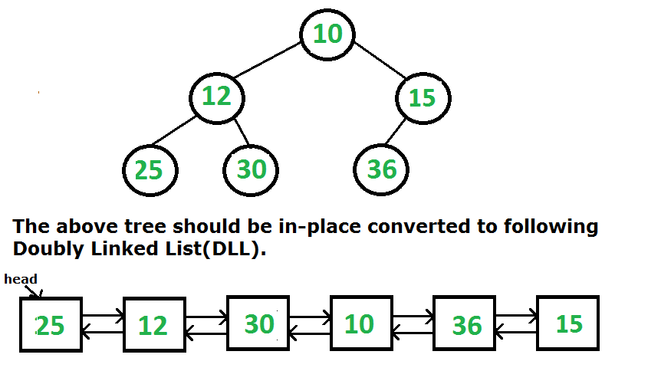
Binary Tree to Doubly Linked List

Slide 10
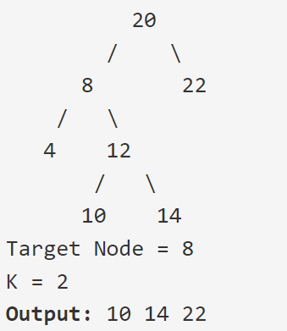
Print all Nodes at a distance k from a given node

Slide 11
THANK YOU

